Slide 1
MECH 492/892
Introduction to Scientific Computing Instructor: Showmic Islam
Email: sislam2@unl.edu

Slide 2
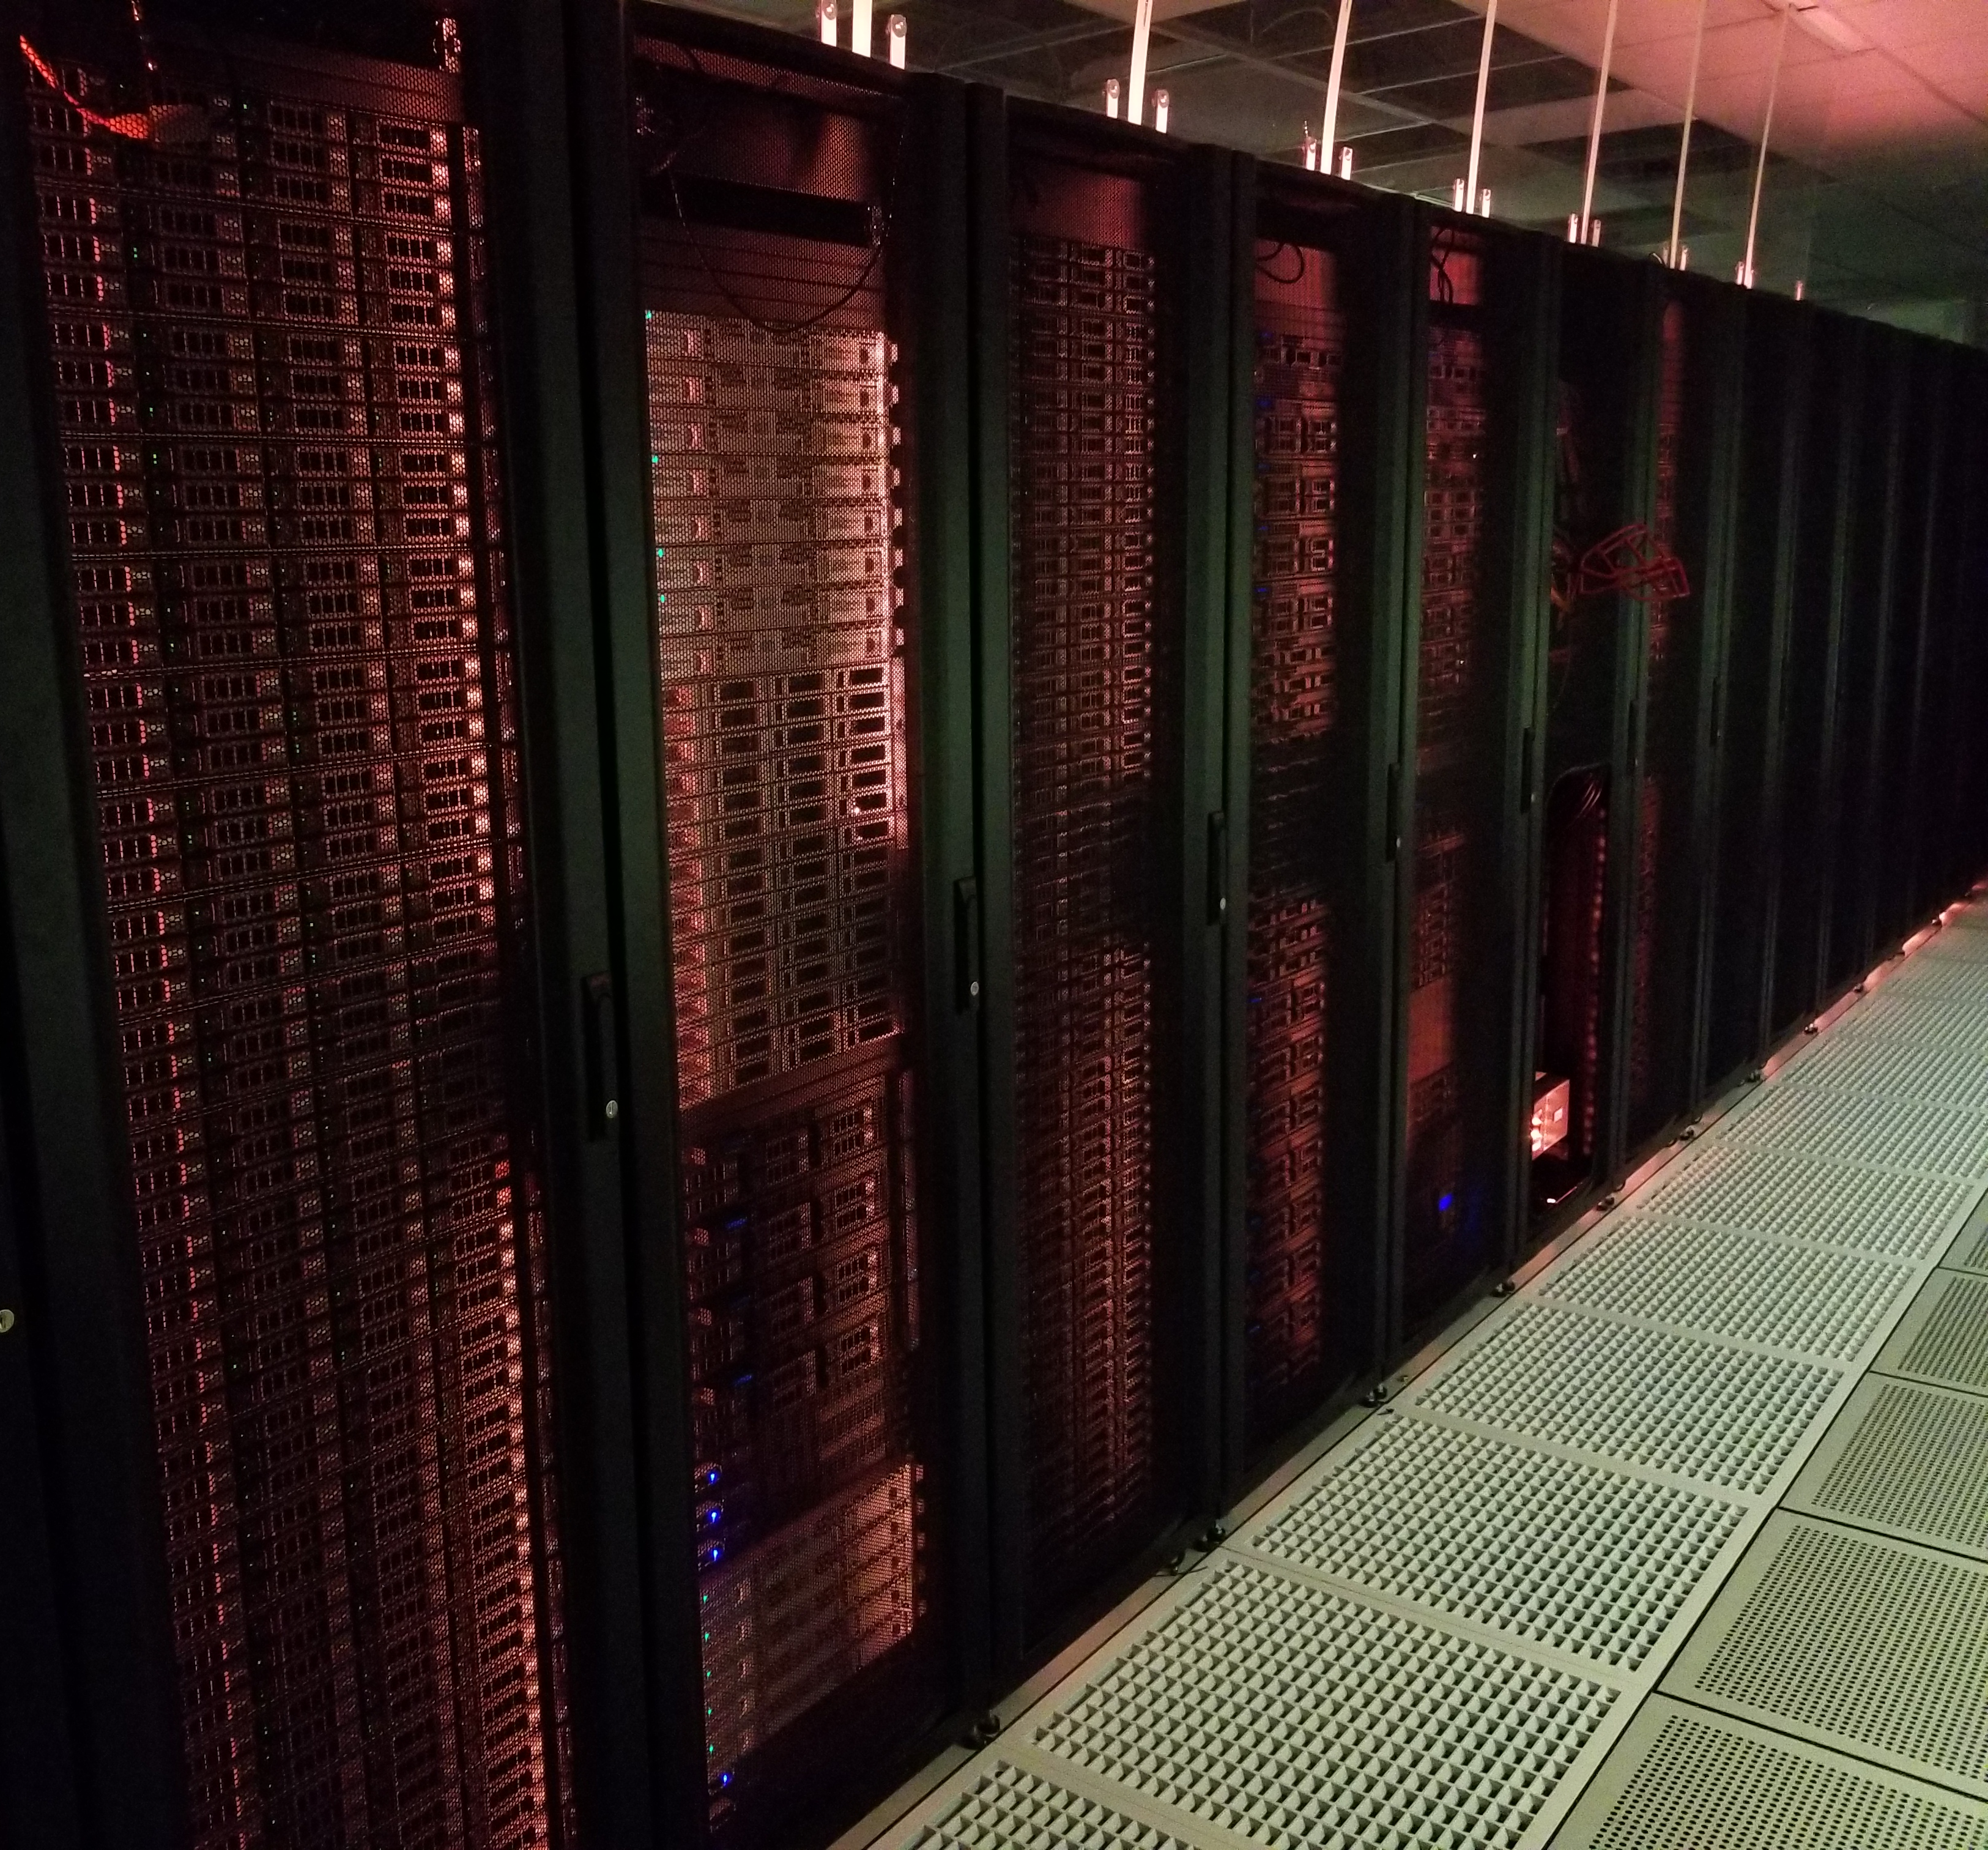


Recap
Physical Setup of cluster
Access
OS: Unix
Red Hat Enterprise Linux
Centos
No Graphical User Interface (GUI)
Communicate through Command Line interface (CLI)
1. Log in to super Computer through SSH

Slide 3

Background
Humans and computers commonly interact
A keyboard
A mouse
Touch screen interfaces
Speech recognition systems
graphical user interface (GUI). (The most widely used way to interact with personal computers) BUT (delivering instructions to a computer scales very poorly)

Slide 4
Background
E.g. :
Copy the third line of one thousand text files in one thousand different directories and paste it into a single file.
Is there a better way?
Using Unix shell.
The Unix shell is both a command-line interface (CLI) and a scripting language, allowing such repetitive tasks to be done automatically and fast.

Slide 5
The Shell
A program where users can type commands.
The most popular Unix shell is Bash (the Bourne Again SHell )
Bash is the default shell on most modern implementations of Unix.
Shell will take some effort and some time to learn.
Learn a few commands
We’ll cover essential command today
Shell allows you to combine existing tools into powerful pipelines and handle large volumes of data automatically.
Sequences of commands can be written into a script, improving the reproducibility of workflows.

Slide 6
The Shell
CLI is often the easiest way to interact with remote machines and supercomputers.
Let’s get started …

